Slide 1
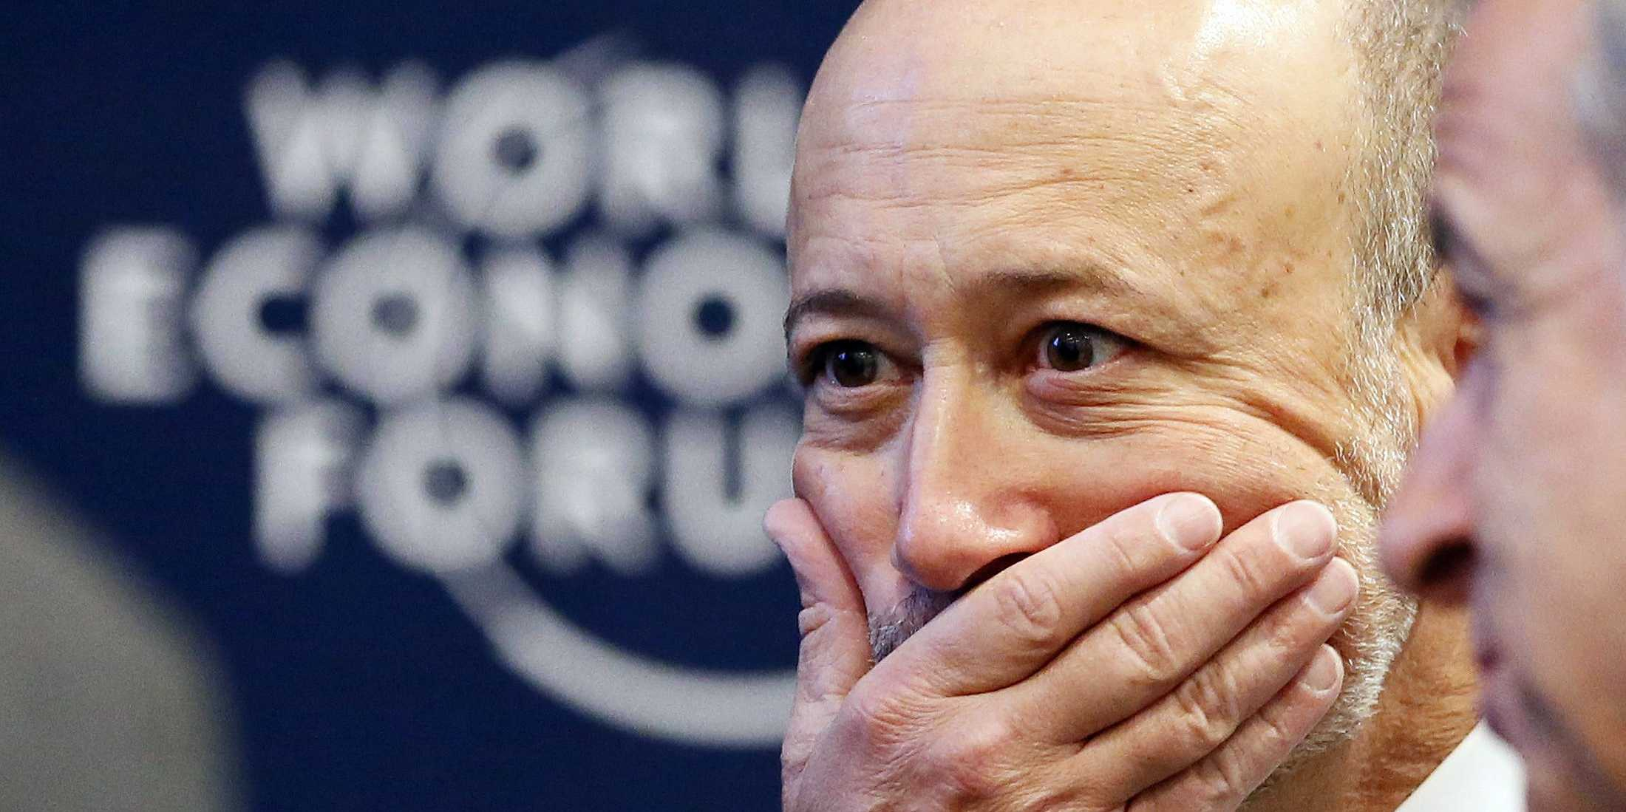
YAMASKA CAPITAL
WORLD’S ONLY HYBRID
TAIL RISK STRATEGY

Slide 2
ABOUT US
Zafer Ulgez, CEO
Certified in Derivatives Markets Strategies, CSI, Canada
Passed all CFA exams, 2012
Financial advisor, Industrielle Alliance, QC, Canada 2009 – 2010
Derivatives Trader (CME & ICE) 2010 - 2015
Oguzhan Dal, Seed Round Investor
Aspiring young entepreneur and industrial engineer. His main focus are early stage companies from commerce, IT, finance and service industry.

Slide 3
SECTOR: TAIL RISK FUNDS
Tail risk hedging funds (Black Swan funds or BSFs) aim to compensate investors’ losses at least partly in the event of a financial crisis by generating high returns when markets are in free fall. Sector has grown fast after 2008 crash.

Slide 4
PROBLEM: COSTLY INSURANCE
If 60/40 balanced portfolio had purchased BSF protection between 2008 – 2015, its compound annual return would have been reduced from 7.56% to 5.52%

Slide 5
CONSEQUENCE
Most investors allocate only 1% - 2% to BSFs to attenuate steep insurance costs. It causes insufficient protection during financial crises.
What if there is a tail risk fund that investors can allocate 5% without worrying about reduced core portfolio return?
Universa BSF returned 115% in 2008. For a core portfolio that returned -40%, inadequate hedge (1%) would contribute 1.55% only.

Slide 6
SOLUTION: ALBATROSS ALGORITHM
Generates higher return than BSFs in financial crises
Positive contribution to the core portfolio in all market conditions

Slide 7
SWOT ANALYSIS
Only tail risk fund, improving performance of the core portfolio in the long term
The algorithm has «J curve». Cumulative return may become negative in the first 3-6 months
Targets large investors that prefer not to hedge tail risk due to ridiculously high costs of BSFs
As popularity of BSFs is fading, many quants work on developing effective tail risk strategies

Slide 8
TARGET MARKETS
LARGE PENSION
FUNDS
FORTUNE 100
CORPORATIONS
SOVEREIGN WEALTH FUNDS

Slide 9
MAIN BENEFIT
Increases annual return of
a pension fund by 45%
Improves earnings stability of
a Fortune 100 corporation
4.5 billion USD per year for
a Sovereign Wealth Fund

Slide 10
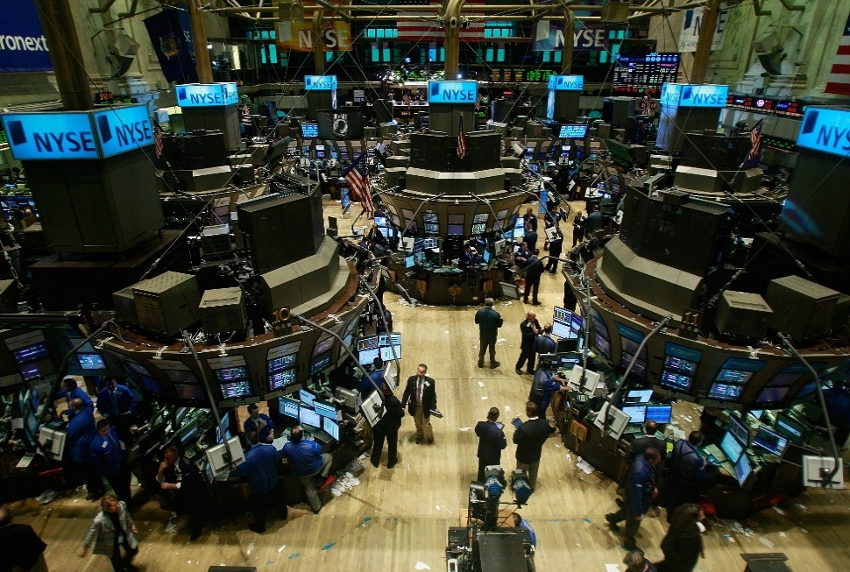
IMPLEMENTATION STRATEGY
Proprietary fund will be managed to establish a track record
Algorithm will be coded to enable automated trading
Exit by selling to a Fortune 100 corporation

